Slide 1

Parent Orientation
Welcome to A1A
and the
Talega Preparatory Academy
MARGUERITE GASPAR, MS
FOUNDER & DIRECTOR

Slide 2

About the A1A and Talega Preparatory Academies
We’re excited to have you join us!
This orientation will provide an overview of our program, your next steps, and how to navigate your independent study all year.

Slide 3

What is the Talega Preparatory Academy? What is the A1A?
Talega Prep was established in 2002 to provide administrative services and support to California Homeschool Families. TPA is now registered in both California and Florida as a private school and serves families nationwide..
A1A is a program offered under the Talega Prep Umbrella School designed specifically to serve elite athletes with high quality, flexible academic opportunities
All progress reports and transcripts for A1A athletes are issued by the Talega Preparatory Academy and bear the WASC seal of accreditation.

Slide 4
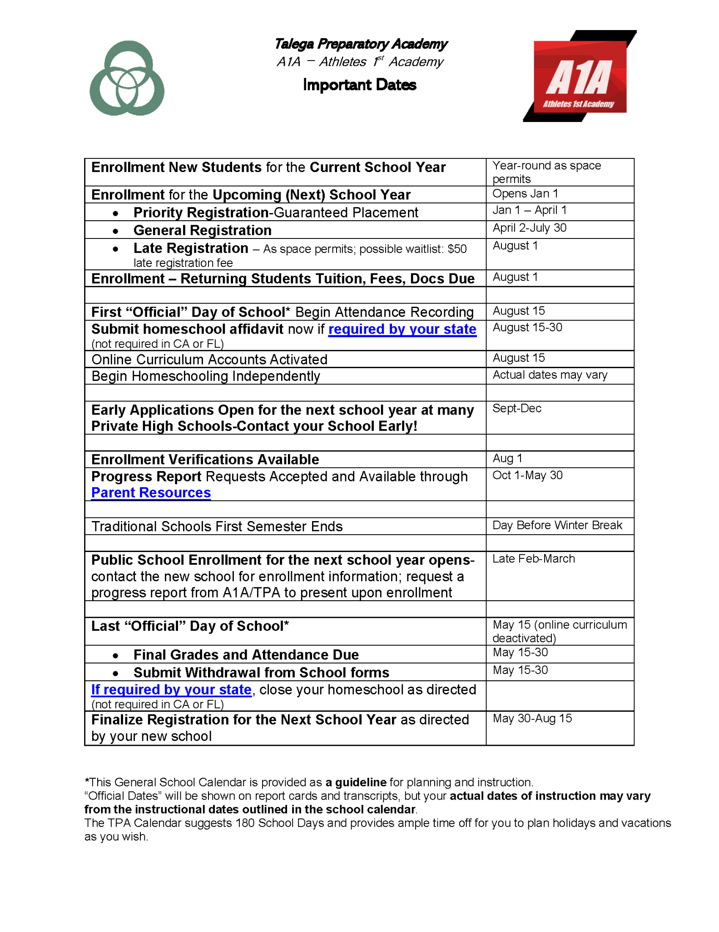
A1A
School Year
at a Glance
8/15-5/15
Note Important Dates

Slide 5
Whether you are using your own curriculum or A1A’s online curriculum
All Assignments Must Be Completed by May 15th, our Official Last Day of School
Parents must complete the Withdraw Process by May 31st

Slide 6
What Are Our Next Steps? What Do We Do?
Have you withdrawn from your previous school or district? If not, Do it now!
Have you notified your local high school that your child will not be attending in the fall? If not, Do it now! Send and email or make a call to the office and advise that your child will be attending a private school this year and ask that they remove your child from their roster.
Provide our contact information: admin@a1a.prep.com

Slide 7
What Are Our Next Steps? What Do We Do?
Whether you are using your own curriculum or A1A’s online program, prepare and plan to begin on August 15th and finish on May 15th.
If you need an earlier start date, please use the Parents Resources help request for “Online Curriculum Help.”
Send us a detailed message of your needs.

Slide 8
What Are Our Next Steps? What Do We Do?
If you are using A1A’s online curriculum, an email with your child’s username and password plus the curriculum site’s link and address will be sent to the primary parent email by August 15th or, in the case of late registration, within 2 weeks of enrollment.
If you have purchased the Elite Academic Support Package, your teacher will be in touch with you the first week of school to arrange your scheduled sessions

Slide 9
What Are Our Next Steps? What Do We Do?
Bookmark this page:
A1A Parent Resources
You will go here for all your needs and requests!

Slide 10
Staying Connected
Contact us: Use our Parent Resources page to send us a message, request help, or obtain school documents.
Parent Resources contains Help Requests, Important Dates, Announcements, links to online curricula, and more.
Reach us by email:
For records or transcripts: Registrar@a1aprep.com
For general administrative assistance: Admin@a1aprep.com.
We communicate regularly through schoolwide emails and announcements at Parent Resources. Check your Spam.

Slide 11
What you will find at Parent Resources:
Click Here
to find out

Slide 12


Thank you for joining us!

